Slide 1


Slide 2
Progressive Enhancement in Action

Slide 3
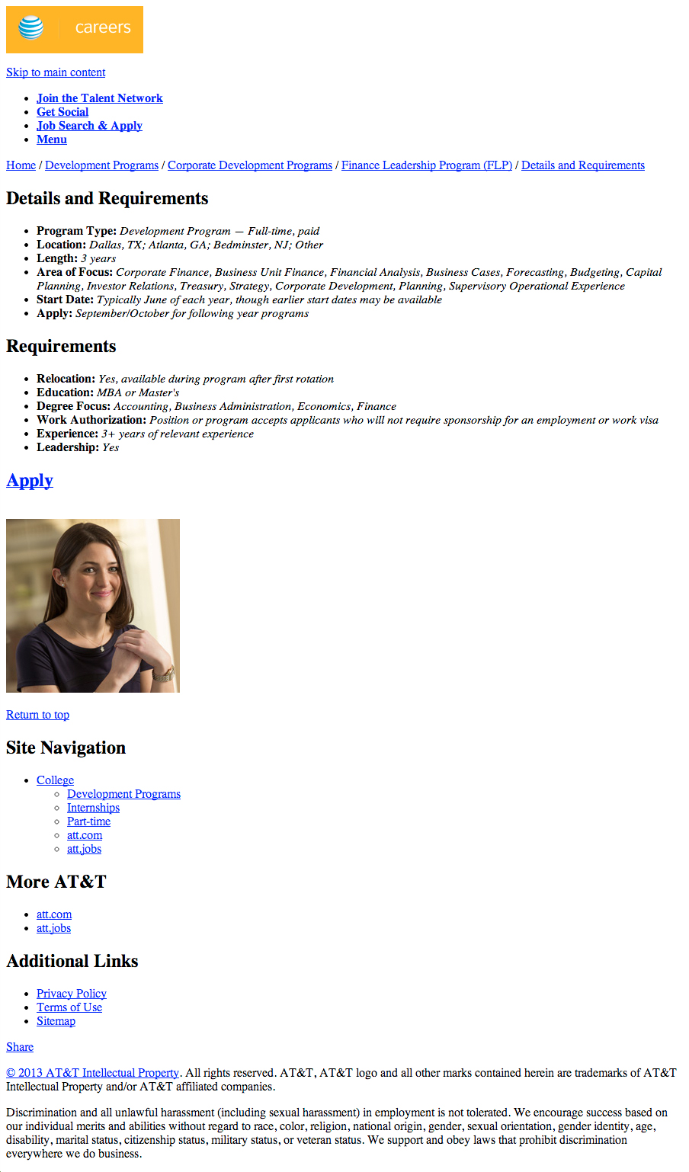
Progressive Enhancement in Action: Content First & Strong Foundations
Notes:
Content first. This is why people visit web sites and why content strategy is so important! Here we have our content, marked-up with a semantically rich foundation of HTML. The lingua franca of the web.

Slide 4
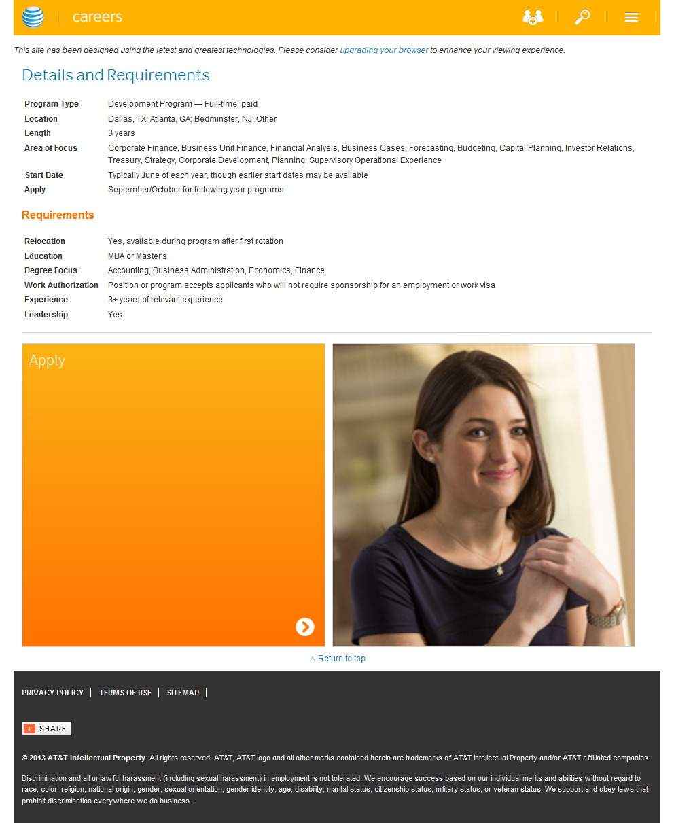
Progressive Enhancement in Action: Building for the Baseline
Notes:
In development, we typically target the mobile experience first. By focusing on the baseline experience and layering in basic CSS and JavaScript (think of it like adding icing to a cake), we can still serve up an acceptable experience on older mobile devices and thereby attain greater device reach. Here we have IE8 with basic styling. Because IE8 does not support advanced styling techniques that the majority of other browsers do, it receives the “mobile” or “basic” layout. This is perfectly normal (and acceptable) behavior on older desktop and mobile browsers!
Cross-browser pixel perfection on even slightly older browsers inhibits us from truly embracing progressive enhancement.

Slide 5
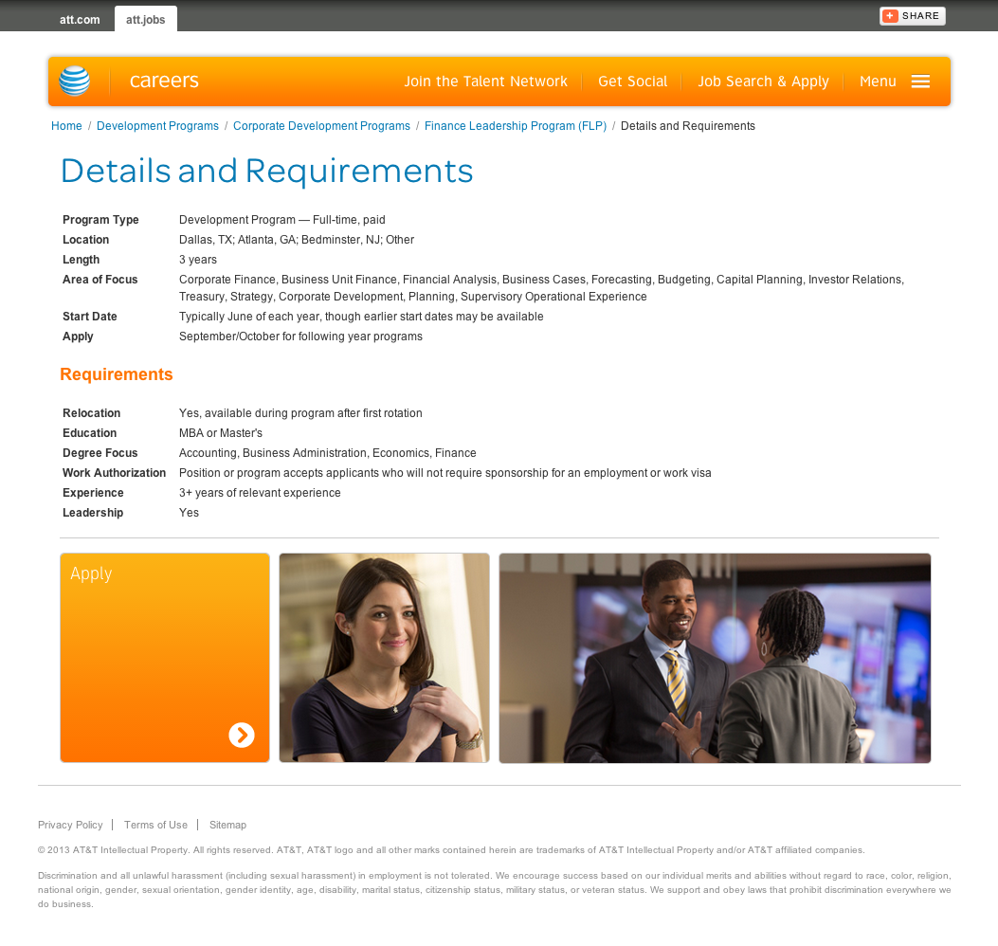
Progressive Enhancement in Action: Adding Layers
Notes:
As we continue to layer in more sophisticated styling, our design begins to take shape and come closer to the more enhanced vision given to us by our creative team. However, our wireframes and comps indicate that this content is to live within a modal window, so…

Slide 6
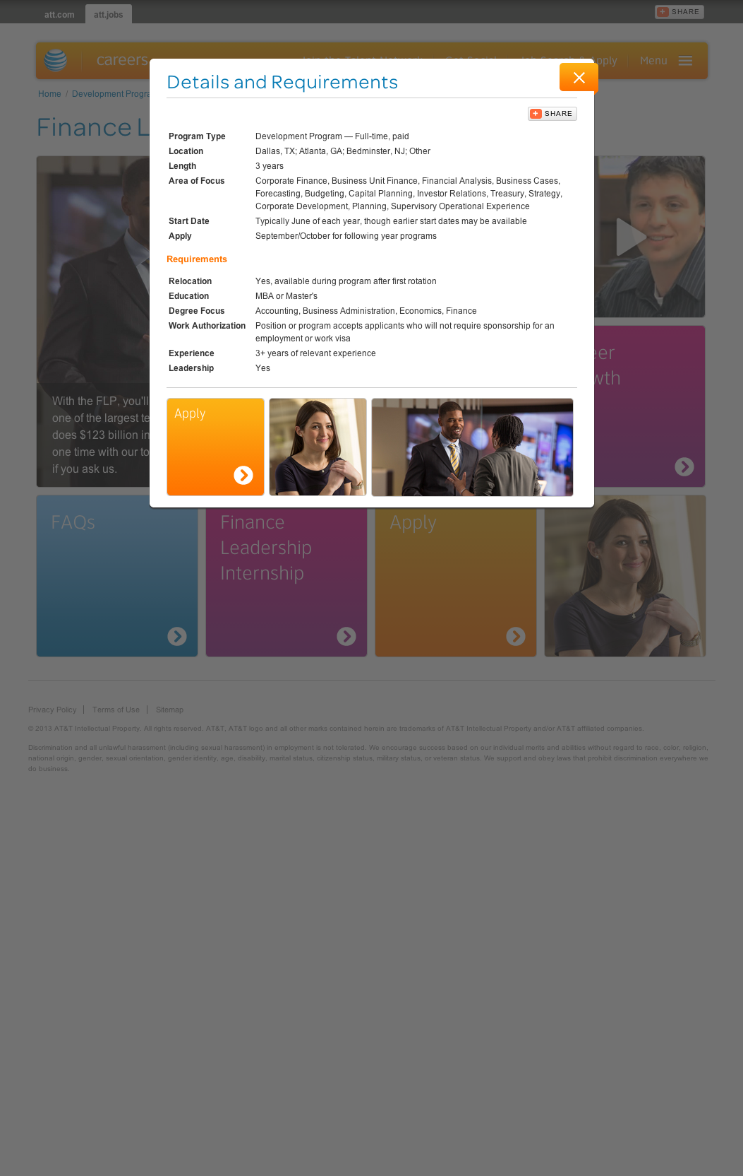
Progressive Enhancement in Action: Final Enhancement
Notes:
…with a little Ajax magic, introduced under the right conditions (in this case a larger viewport), we can now load up this content as desired.

Slide 7
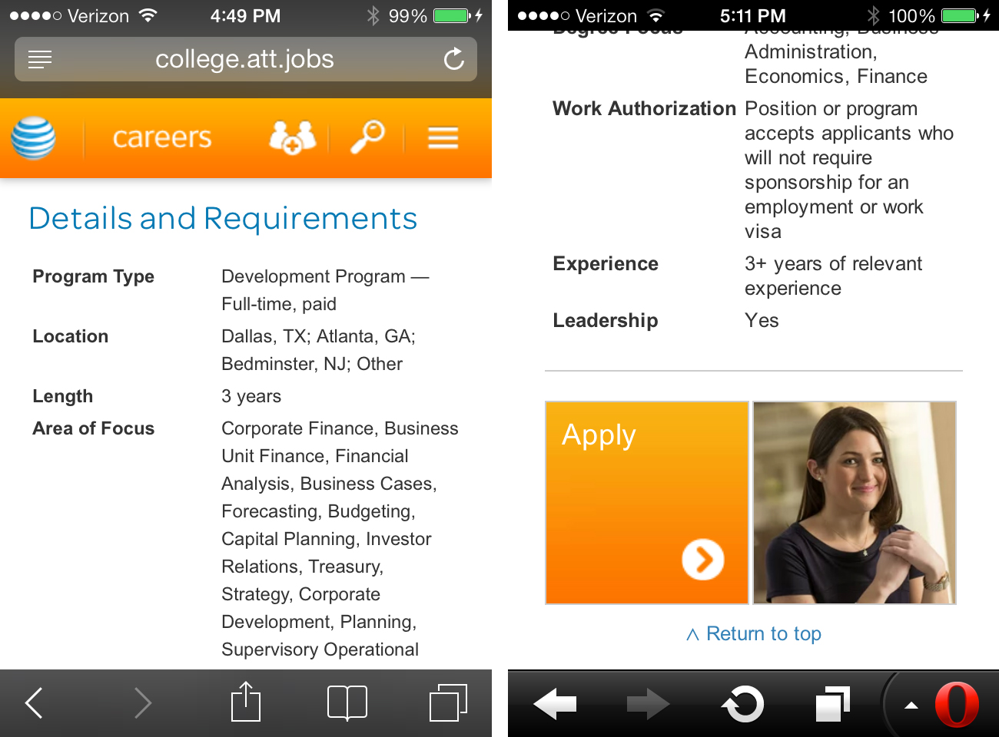
Progressive Enhancement in Action: Greater Control
Notes:
Here we have the same page as seen on iOS 7 Safari and Opera. With the progressive enhancement and responsive design one-two punch, we wield great control over our layouts on many devices.

Slide 8
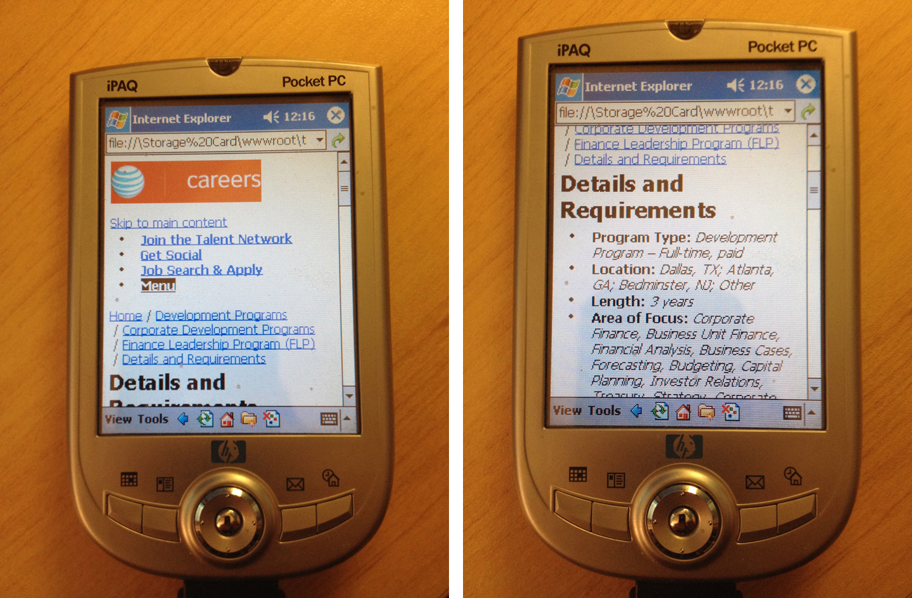
Progressive Enhancement in Action: Our Future Depends On It
Notes:
To come around full circle , here is how this particular page looks on Spell’s 11 year old HP Pocket PC! Because we have taken the time to construct this experience from the baseline up, we have created universally accessible content and cross-device content parity (http://bradfrostweb.com/blog/mobile/content-parity/).
Progressive enhancement gives us great power! The days of catering to one or two browsers are over. Embracing Progressive enhancement is the best strategy our company can take to design and develop for today’s and tomorrow’s device market.

Slide 9
Thank you!
Follow me on twitter @Spellacy

